Slide 1
Guidelines for the Management of Severe Traumatic Brain Injury
Rachel Garvin, MD
July 28, 2017
Neuroscience Grand Rounds

Slide 2
Traumatic Brain Injury
TBI contributes to 30% of injury related deaths in the US
90% of total cost of TBI are related to severe TBI
Falls are the leading cause of TBI
People over age 65 have highest morbidity/mortality

Slide 3
Grading TBI
Mild
GCS 13-15
Moderate
GCS 9-12
Severe
GCS 3-8

Slide 4
Heterogeneous Injury

Slide 5
Perceived TBI Management

Slide 6
Current Issues with Research
Difficulty establishing effectiveness of interventions
Standardizing clinical management
Relevant outcome measures and time to follow up
Notes:
Recommendation made by Clinical Trial sin Head Injury Study Group

Slide 7
A Word About Guidelines
Guidelines are recommendations
Where do the recommendations come from?
What is the quality of the evidence?
Know why.

Slide 8
Brain Trauma Foundation
Founded in 1986 to support TBI research
First EB guidelines published 1995
Six additional TBI guidelines
Severe TBI
Peds Severe TBI
Early Prognosis in Severe TBI
Surgical Management of TBI
Pre-hospital TBI Management
Field Management of Combat TBI

Slide 9
4th edition 2016
Previous guidelines 2007
Brain Trauma Evidence-Based Consortium (BTEC)
18 topics discussed
Out of 189 publications reviewed, 5 class 1
94 new studies since last publication
Recommendations, not a protocol
Notes:
Guidelines have led to 50% reduction in severe TBI deaths
4th edition 2016 – Piblished in Neurosurgery
BTEC: BTF and Pacific Northwest Evidenced based practice center at OHSU, overseen by Stanford and funding from DOD

Slide 10
Included Topics
Treatments
Decompressive Craniectomy
Prophylactic Hypothermia
Hyperosmolar Therapy
CSF drainage
Ventilation Therapies
Sedation
Steroids
Nutrition
Prophylaxis: Infection, DVT, Seizure
Monitoring
ICP
CPP
Advanced monitoring
Thresholds
BP
ICP
CPP
Advanced monitoring
Notes:
Monitoring: benefits and risks
Thresholds: values to target or avoid

Slide 11
Rating of Evidence
2 reviewers evaluated each study
Rated as class 1,2 or 3 based on study design and quality rating
Class 1: good quality RCT
Class 2: moderate-quality RCT, good quality cohort or case-control
Class 3: Low quality RCT, mod/low quality cohort or case control and case series
Notes:
Not all Class 1 studies contribed d to a level 1 recommendation

Slide 12
Quality of the Body of Evidence
Quality of each individual Study
Consistency of results across similar studies
High, Moderate, Low, NA (one study)
Directness of study population
Direct, indirect, mixed
Precision of the estimate of outcome effect
High, moderate, low
Confidence intervals, p-values
Notes:
Looking at consistency, directness, precision

Slide 13
Level of Recommendation: Quality of Evidence + Class of Study
Level I: high quality evidence
Level II A: moderate quality of evidence
Level IIB and III: low-quality of evidence
IIB: Class 2 studies, direct evidence but overall low quality
III: Class 3 studies or Class 2 with only indirect evidence
Notes:
IIB = class II studies; Level III = class 3 studies or class 2 with indirect evidence

Slide 14
Hyperosmolar Therapy
No specific recommendations due to insufficient evidence
Previous recs
Mannitol works but watch for hypotension
Only use mannitol if patient is herniating
Focus was on comparative effectiveness of different hyperosmolar agents
Notes:
3rd edition did not focus on comparative effectvenss of agents so could not be included in recommendations

Slide 15
Notes:
4th edition: 1 class 2 and 2 class 3, rest were from 3rd edition
The class 2 study was from multiple trauma centers but all in NY → ? applicability

Slide 16
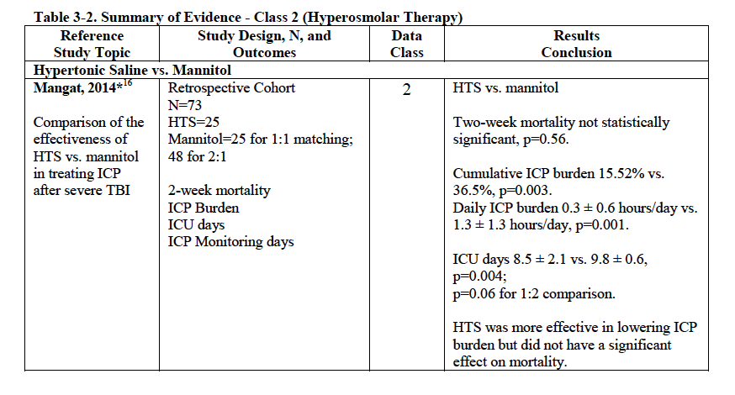
Notes:
Mangat: 1:1 matching for primary analysis, 1:2 for sensitivity analysis

Slide 17
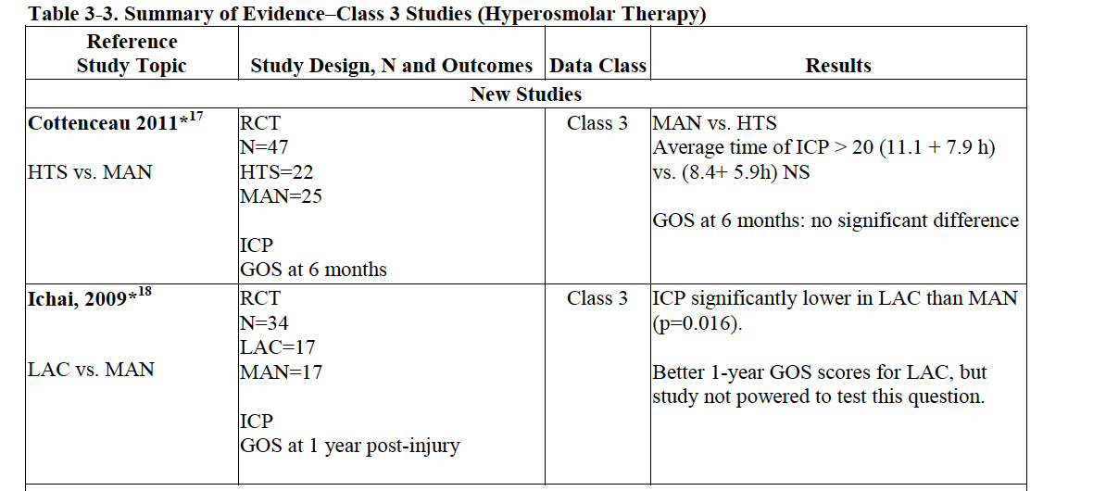
Hyperosmolar Class 3, 4th edition
Notes:
All other class 3 studies 1984 – 1999
LAC = Na+ lactate

Slide 18
CSF Drainage
Closed for ICP monitoring vs open for drainage
Level III recommendations:
Continuous drainage for GCS <6 during first 12 hours
Continuous drainage may be more effective in lowering ICP
Notes:
Questions: continuous vs intermittent to lower ICP; does CSF drainage result in lower mortality
12 potentially new studies → only 2 included

Slide 19
CSF Drainage
Notes:
Level III recommendation: can consider using continuous drainage as maybe more effective and during the first 12 hours to lower ICP. EVD use showed increase mortality

Slide 20
Decompressive Craniectomy
Level IIA Recommendations:
Bifrontal not recommended to improve 6 month outcomes in:
Diffuse injury
ICP >20 for >15 minutes in 1 hour period refractory to first-tier tx
If you are going to do a FTP DHC, do a large one, not small
Shown to decrease mortality and improve outcomes
Notes:
But – bifrontal crani does show decreased ICP and decreases ICU days
Large FTP = 12 x 15

Slide 21
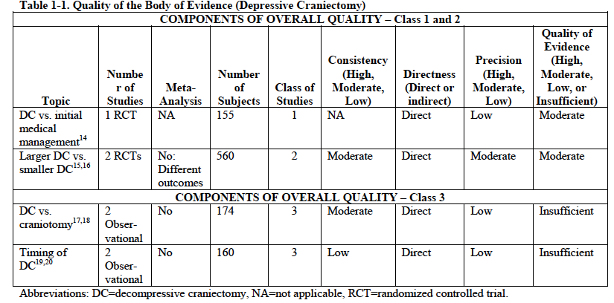
Decompressive Crani
31 potential studies →21 excluded
Notes:
The DECRA trial (Class 1 study) – compared bifrontotemp crani to initial medical management in refractory raised CIP → lower ICP and fewer ICU days but no improvement in outcome
RESCUE ICP (not published before BTF guideline: Bifrontotemp crani vs medical management → decrease mortality but increased vegetative state (large crossover group)

Slide 22
Ventilation Therapies
PaCO2 strongest determinant of cerebral blood flow → linear response within a range
3rd edition recs not carried over
IIB Recommendation:
Prophylactic hyperventilation with PaCO2 <25 not recommended
Notes:
PaCO2 20-80mmHg
3rd edition recs: from case series, not comparative studies
Previous recs: can use hyperventilation as a temporizing method and if you do use it, use SJo2

Slide 23
Ventilation Therapies
Notes:
4 potentially new studies → all exxcluded. One study from previous edition

Slide 24
Ventilation Therapies
Notes:
Hyperventilation with or without THAM (a buffer) to prevent acidifcation of CSF with hypocarbia
Patient’s stratified based on motor component of GCS

Slide 25
Sedation
No changes from 3rd edition
Level IIB Recommendations:
Can use barbiturates to control ICP refractory to other medical treatments but not recommended to burst suppress
Propofol can be used to control ICP but not to improve outcomes
Notes:
Focus of questions: do barbs reduce ICP and improve outcomes? Do sedatives improve outcomes?
Studies used for recs were conducted 15-30 years ago

Slide 26
Sedation
Notes:
9 new studies – 5 excluded for not meeting criteria, other 4 were class 3. Class 3 studies not used for recs as all had major flaws or null findings.
Cochrane review of barbs for TBI 1999 → no significant changes to updated review in 2012

Slide 27
Therapeutic Hypothermia
Level IIB Recommendation:
Prophylactic tx NOT recommended
Most new studies were class 3
Conflicting evidence on treatment
Hypo vs normothermia:
1 class 1 and 3 class 2 from U.S. → no benefit
3 class 2 (China/Japan) → benefit
Notes:
Early = within 2.5 hrs and short term = 48 hours

Slide 28
Seizure Prophylaxis
Level IIA Recommendation
Phenytoin not recommended to prevent late PTS
Can consider to prevent early PTS
No new recommendations from 3rd edition
Levetiracetam:
1 class 2 vs phenytoin
1 class 3 vs phenytoin
Notes:
2 new class 2 and 4 new class 3 added but did not change recs
Questions: effectiveness of proph to prevents early vs late; adverse efects; comparative agents and placebo
Current studies with insufficent evidence for or against use of keppra

Slide 29
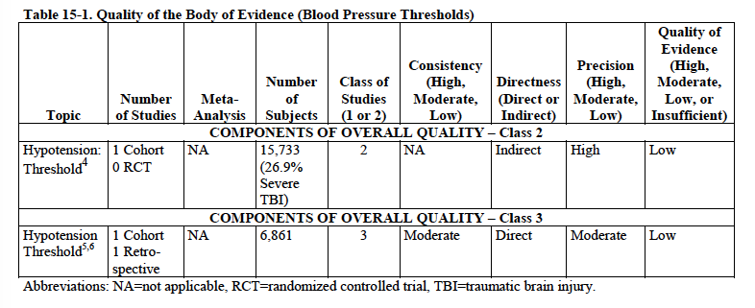
Blood Pressure
Level III Recommendation:
SBP >/= 100mmHg ages 50-69
SPP >/=110mmHg for ages 15-49 and >70
Notes:
8 new studies and 5 excluded
Class 2 study : single study providing indirect evidence (mod and severe TBI and outcomes grouped)
Changes from 3rd edition: threshold >90 previously
Studies from 3rd edition: hypotension is bad

Slide 30
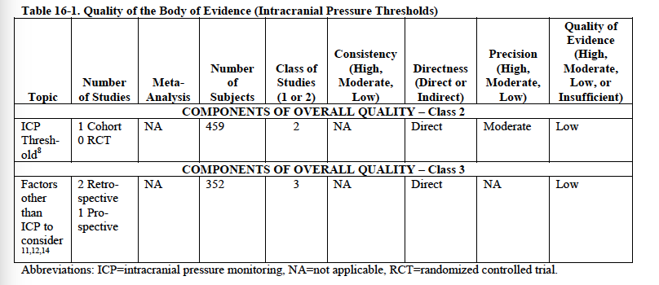
ICP
Level IIB Recommendation:
Treat ICP >22mmHg to decrease mortality
Notes:
Indications for monitoring: Level IIB: using ICP to manage severe TBI patients recommended to decrease mortatliy
Single class 2 study used for IIB rec on ICP
Level III recommendation on using imaging in addition to ICP to aid in decision making about treatment

Slide 31
CPP
Level IIB Recommendation:
Maintain CPP 60-70
Level III Recommendation:
Avoid pushing CPP >70

Slide 32
CPP
Notes:
Lack of consistency in what the studies tested as well as the results
The RCT (class 3) looked at CPP 50 vs 70 and no difference in outcomes
2 Class 2 cohorts reported better outcomes with higher CPP (60-70)

Slide 33
Summary
One Level I recommendation
Mainly level IIB
Further research is still needed
Use guidelines along with treatment specific for each patient

Slide 34
Food for thought…

